Slide 1
JavaScript – Core Concepts
Agenda
Scopes
Hoisting
Closure
Async JS
OOJS(this & Object Prototypes)
ES6

Slide 2
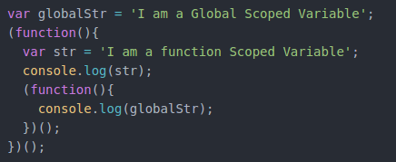
Scopes
How Scopes Work?
Output: ???

Slide 3
Types of Scope in JS
Lexical Scope
Also referred as functional Scope. Variable access is within a function.
Global Scope
Generally refers to the root file’s scope or window scope in Browser.
Block Level Scope
Available from ES6. Variable access is within that block of code.

Slide 4
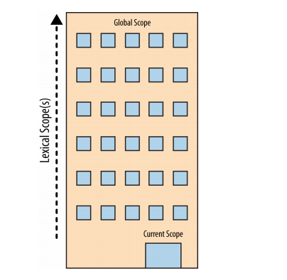
Scope – Look up
Global Scope

Slide 5
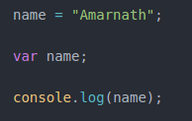
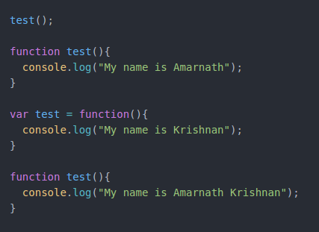
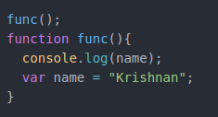
Hoisting – Chicken or the Egg
The variable and function declarations are "moved" from where they appear in the flow of the code to the top of the code.

Slide 6
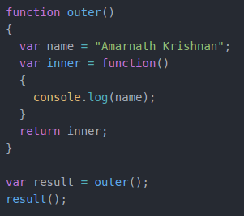
Closure
Closure is when a function is able to remember and access its lexical scope even when that function is executing outside its lexical scope.

Slide 7
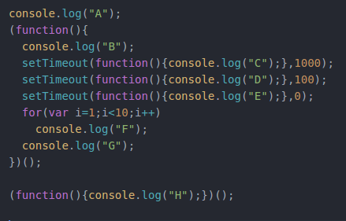
Async JS
JavaScript is Single Threaded
Non Blocking code - Event Loop
Call Stack
WEB API
Task Queue

Slide 8
OOJS
Is JavaScript an OO Language ?
Do we have classes in JS ?
How inheritance work in JS ?
What does Prototypical inheritance/chaining mean?
What is “this context”?
How to dynamically change “this context”?

Slide 9
ES6
let and const keyword
Class and extends
Default Parameter value
Spread Operator
Destructuring
Iterators
static
Promises

